Slide 1


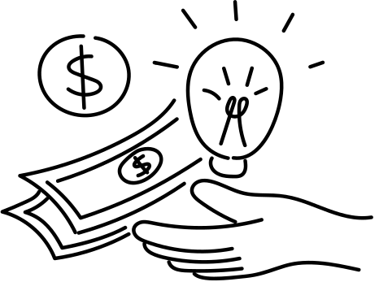
LIFE MESH
TASKFLOW
RAJALAKSHMI INSTITUTE OF TECHNOLOGY
1.AMRUTHA.J
2.GOPALAKRISHNAN.J
3.PRIYADHARSHINI.K
4.KABILAN.S

Slide 2




PROBLEM STATEMENT
Transparency
High Bias
Security
The current payment method is not transparent and can’t be verified about the payments.
The High bias system leads to loss faith among the new freelancers by waiting so long for projects.
Since, every data is centralized, the details can be more vulnerable to the attackers

Slide 3



SOLUTION
Smart Contract
High Bias
Security
Smart contracts are self-executing programs that run on a blockchain to automate agreements between parties and the contracts can be verified.
Our special ML model, promotes the newly joined freelancer with the top position for the project recommendation.
The designing of decentralized platform with the help of IPFS and blockchain for payments, makes the system more secure.

Slide 4

Tasks and freelancers are matched using a ML algorithm, where the matching score is computed off-chain and validated on-chain
Eliminates bias by focusing on skill compatibility, task context, and potential, rather than past experience alone. The matching process is transparent and immutable.
FEATURES
Payments are held in escrow smart contracts until the client approves task completion. Funds are automatically released upon approval or dispute resolution.
Builds trust by ensuring freelancers get paid for completed work while protecting clients from incomplete tasks.
Ensures data security, reduces tampering, and verifies user authenticity without a central authority.
Multiple freelancers can work on a single task, with payouts split via smart contracts based on predefined percentages or milestones.

Slide 5


Overview of current trends
In current trend, the people with more good reviews and more project completion status on his profile will be hired more over by the clients. The new skilled freelancer may see this little bit frustrated, even though they have the skill, they can’t be hired by the clients. This practices will eventually lead to chaos of low user retention and the platform will lead to fail.

Slide 6
Economic implications of current trends
In the current economy, the payments are carried out through UPI, or bank transfer. This will lead to the leak of freelancer or customer details as well as getting paid and not doing work scenarios.

Slide 7
Main challenges identified
01.Algorithm Complexity for Skill Normalization
02.Dynamic Payout Conditions
03.Verification of User Credibility
Designing an ML algorithm capable of standardizing freelancer profiles across diverse metrics, such as GitHub activity, certifications, and past projects, is complex. It requires detailed feature engineering and weighing different metrics appropriately to ensure fair scoring.
Setting minimum payout thresholds and aligning these with the expectations of both clients and freelancers can be challenging, as payouts can vary significantly based on task complexity and market conditions.
Ensuring that the credentials (e.g., GitHub profiles, certifications) provided by freelancers belong to them is non-trivial. Methods like social authentication, email verification, or decentralized identity systems (DIDs) could help but might introduce additional complexity.

Slide 8

Challenges and proposed solutions
Using AI inside the ML model, it will verify the LinkedIn, Git-Hub accounts to verify the authenticity of the user. This ML model mainly involve in a formula, which tackles all of the aspects of the freelancer’s ability to handle the project and provide the wise recommendation. Blockchain technology has been implemented for payment transfer and we can use NFT for verification of documents.

Slide 9
FORMULA
(Alpha x Skills match) + (Beta x Potential match) + (Gamma x Task Context Match) + (Delta x Previous Experience)

Slide 10

Comparison
Current Results
Previous Periods
A better way to give the recommendations considering all the parameters required for this project to analyse.
No recommendation system, which considers all the parameters like, Skills, potential match, Task context match, and previous experience.

Slide 11

Conclusion
01.
02.
Provide jobs for new joiners based on their skills. Utilize blockchain technology for secure and transparent operations
Enable seamless transactions using online currency. Foster accessibility and growth in a decentralized ecosystem.

Slide 12
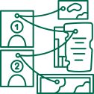

SCALABILITY
The platform connects individuals of all skill levels with consumers needing specific services.
It offers a variety of tasks suited to different abilities.
A skill-based matching system helps beginners gain experience while providing consumers with a diverse talent pool.
The platform scales its infrastructure to handle growing demand and ensure faster connections.
Continuous learning opportunities allow users to improve their skills.
The marketplace remains scalable and accessible for all.

Slide 13
THANK YOU
SO MUCH!
feel free to ask questions

